Slide 1

Workplace Impact On Mental Health

Slide 2
Dataset
This dataset is from a 2014 survey that measures attitudes towards mental health and frequency of mental health disorders in the tech workplace.
Content
This dataset contains the following data:
Timestamp
Age
Gender
Country
state: If you live in the United States, which state or territory do you live in?
self_employed: Are you self-employed?
family_history: Do you have a family history of mental illness?
treatment: Have you sought treatment for a mental health condition?
work_interfere: If you have a mental health condition, do you feel that it interferes with your work?

Slide 3
Content Contd..
no_employees: How many employees does your company or organization have?
remote_work: Do you work remotely (outside of an office) at least 50% of the time?
tech_company: Is your employer primarily a tech company/organization?
benefits: Does your employer provide mental health benefits?
care_options: Do you know the options for mental health care your employer provides?
wellness_program: Has your employer ever discussed mental health as part of an employee wellness program?
seek_help: Does your employer provide resources to learn more about mental health issues and how to seek help?
anonymity: Is your anonymity protected if you choose to take advantage of mental health or substance abuse treatment resources?
leave: How easy is it for you to take medical leave for a mental health condition?
mentalhealthconsequence: Do you think that discussing a mental health issue with your employer would have negative consequences?

Slide 4
physhealthconsequence: Do you think that discussing a physical health issue with your employer would have negative consequences?
coworkers: Would you be willing to discuss a mental health issue with your coworkers?
supervisor: Would you be willing to discuss a mental health issue with your direct supervisor(s)?
mentalhealthinterview: Would you bring up a mental health issue with a potential employer in an interview?
physhealthinterview: Would you bring up a physical health issue with a potential employer in an interview?
mentalvsphysical: Do you feel that your employer takes mental health as seriously as physical health?
obs_consequence: Have you heard of or observed negative consequences for coworkers with mental health conditions in your workplace?
comments: Any additional notes or comments

Slide 5
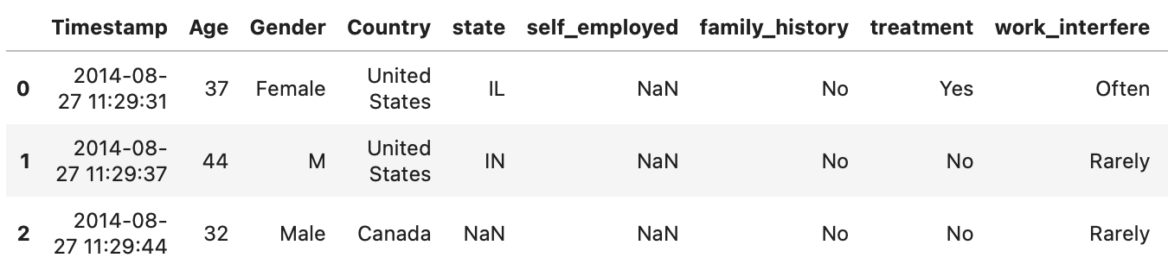
Sample Data

Slide 6
Variables which can be useful?
Age
Gender
family_history
treatment
benefits
wellness_program
seek_help
Observation on the Dataset:
Only considering survey results from United States as its the majority.
Noticed some negative numbers under 'Age' column which I will filter out.
Under 'Gender' column, I see lot of variation and spelling error like Male, Mail, maile, M, Cis Male, Female, Cis Female, etc. I will make it consistent as Male, Female, Other.
Dropped some columns like State, No of Employee, self_employed, etc. as I don't think they add much value.
Basically, I am looking for how many people suffering from mental problems opted for 'Treatment'.
Mental health is often overlooked which many times leads up to serious health issues. So, I believe early detection is the key to tackle this.
Workplaces which promotes mental health and support their employees through different benefits and wellness programs will see more people opting for treatments and other kind of help if needed.

Slide 7
Variable Description
Age: Person's Age
Gender: Person's Gender
family_history: Do you have a family history of mental illness?
treatment: Have you sought treatment for a mental health condition?
benefits: Does your employer provide mental health benefits?
wellness_program: Has your employer ever discussed mental health as part of an employee wellness program?
seek_help: Does your employer provide resources to learn more about mental health issues and how to seek help?

Slide 8
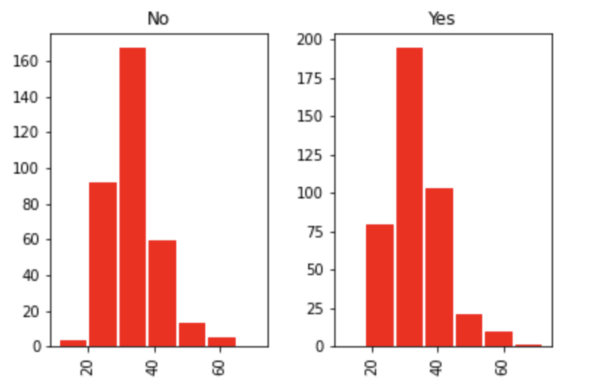
Histogram for the Selected Variables
Explanatory Variable ‘Age’ vs dependent Variable ‘Treatment’

Slide 9
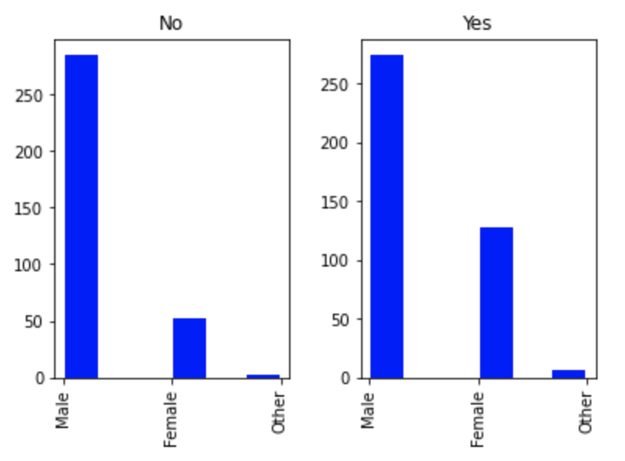
Contd..
Explanatory Variable ‘Gender’ vs dependent Variable ‘Treatment’

Slide 10
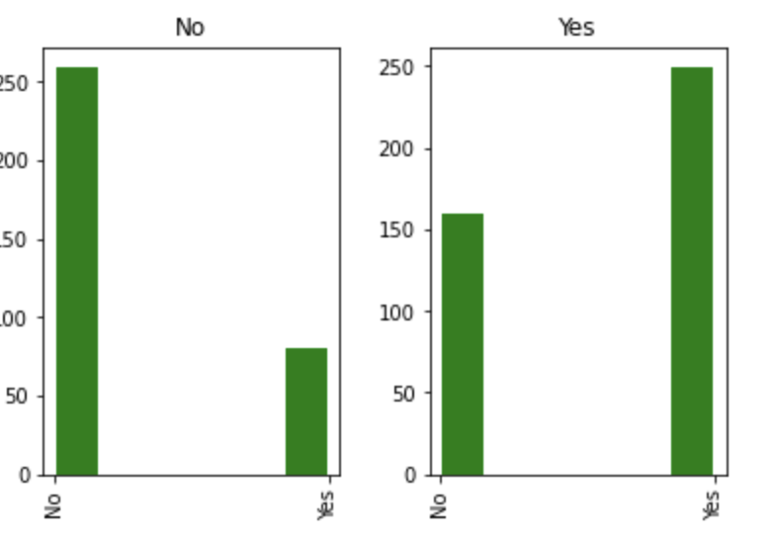
Contd..
Explanatory Variable ‘family_history’ vs dependent Variable ‘Treatment’

Slide 11
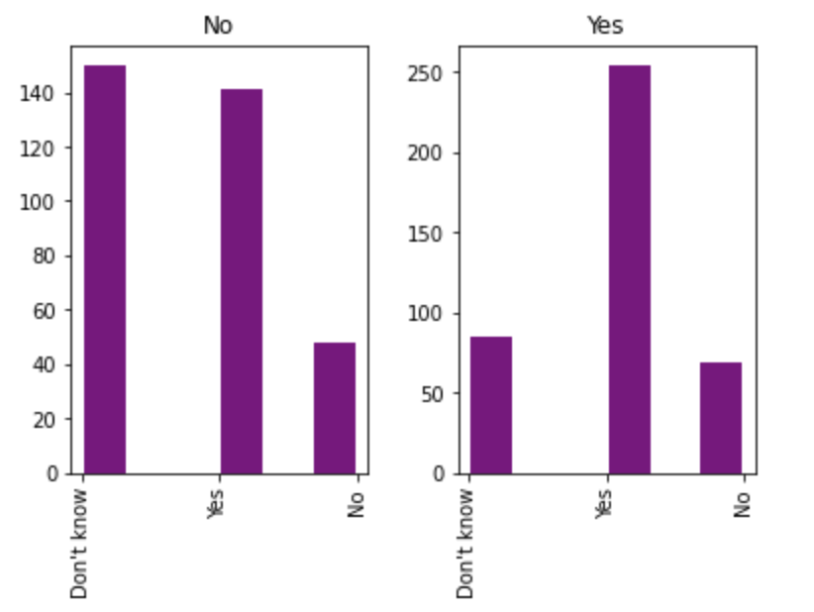
Contd..
Explanatory Variable ‘benefits’ vs dependent Variable ‘Treatment’

Slide 12
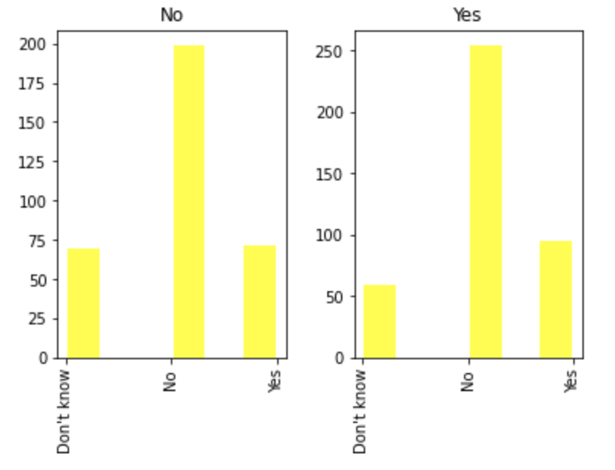
Contd..
Explanatory Variable ‘wellness_program’ vs dependent Variable ‘Treatment’

Slide 13
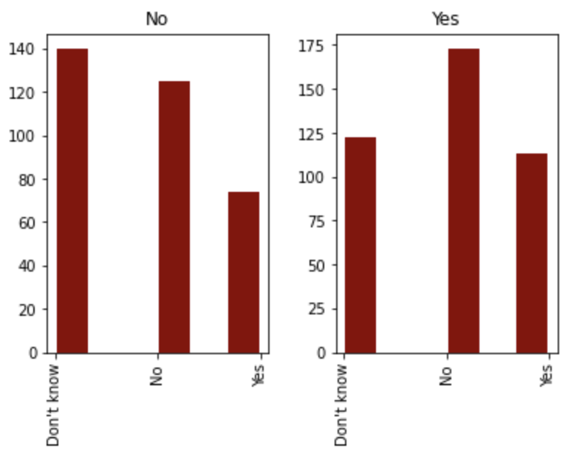
Contd..
Explanatory Variable ‘seek_help’ vs dependent Variable ‘Treatment’

Slide 14
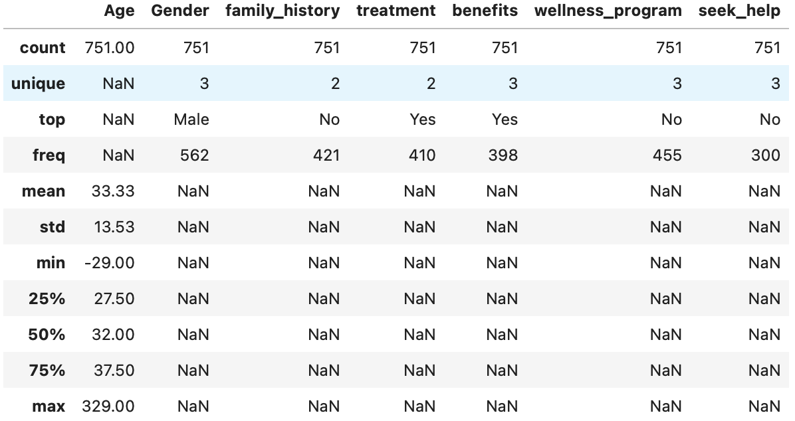
Other descriptive characteristics about the variables: Mean, Mode, etc.

Slide 15
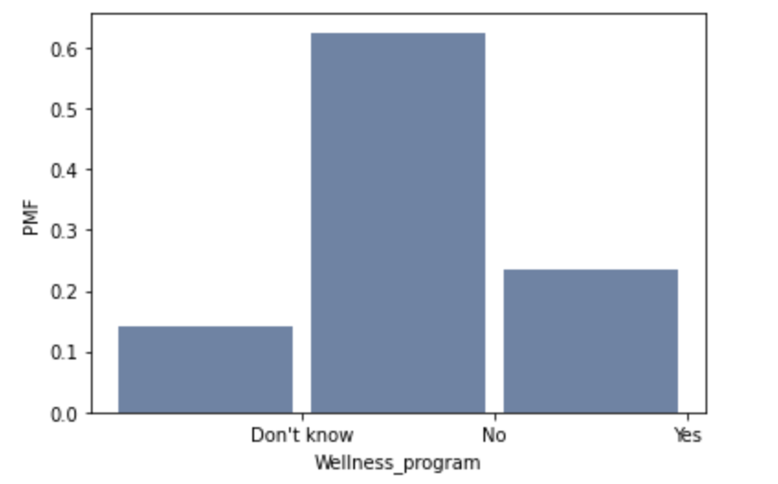
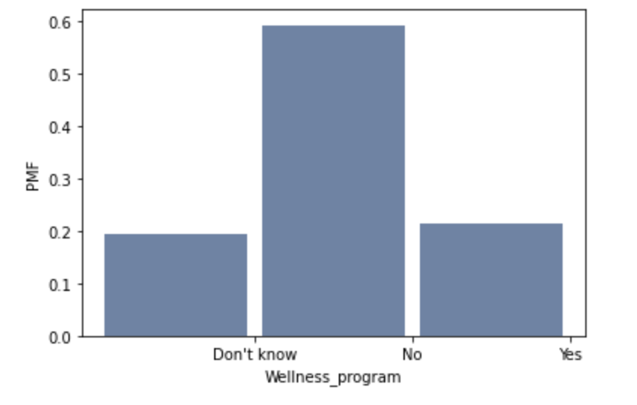
Compare two scenarios in your data using a PMF
People With Family History of Mental Health Issues
People With No Family History of Mental Health Issues
Slightly better results seen for people
With Family history.

Slide 16
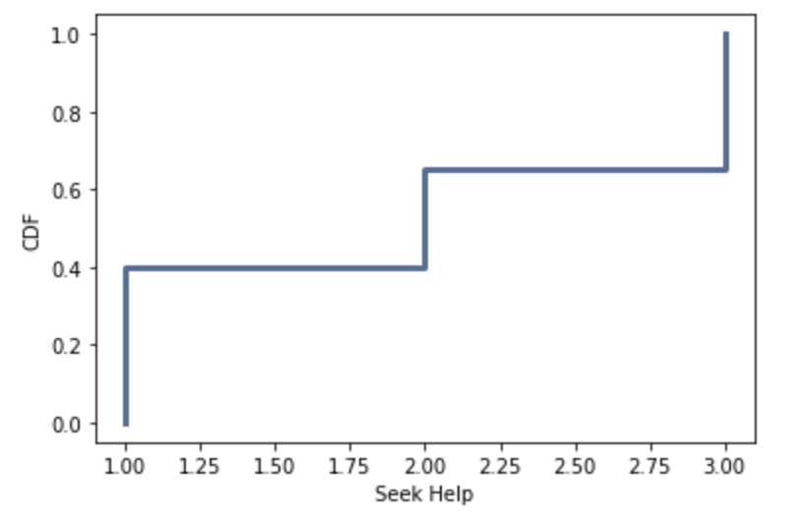
Create 1 CDF with one of your variables
Explanatory Variable ‘seek_help’ is used to create CDF.
Result doesn’t add much value to the analysis.

Slide 17
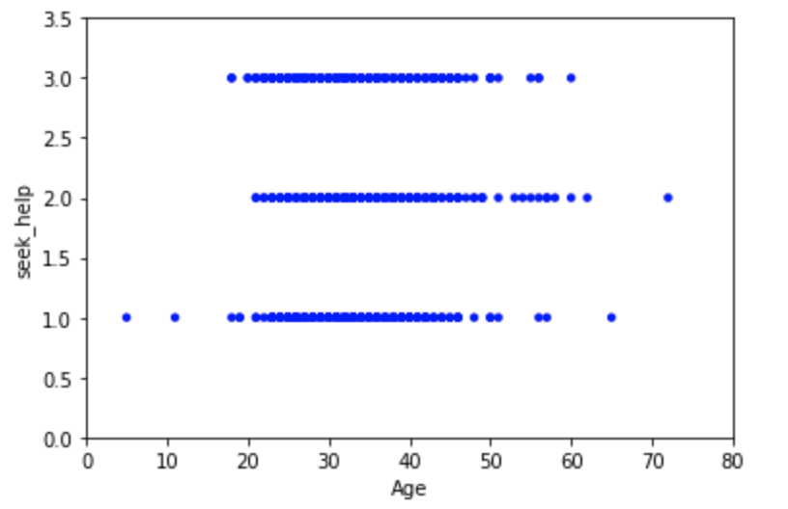
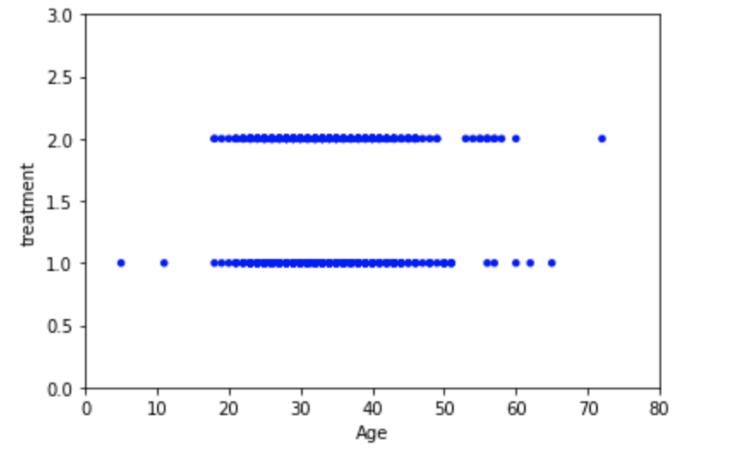
Create two scatter plots comparing two variables
Scenario 1: Using Explanatory variables Age and Seek_help
CoVariance & Correlation of Age and Seek_help
Is in negative.
Scenario 2: Using Explanatory variable Age and dependent variable Treatment
CoVariance & Correlation of Age and Treatment
Is in positive and slightly better.

Slide 18
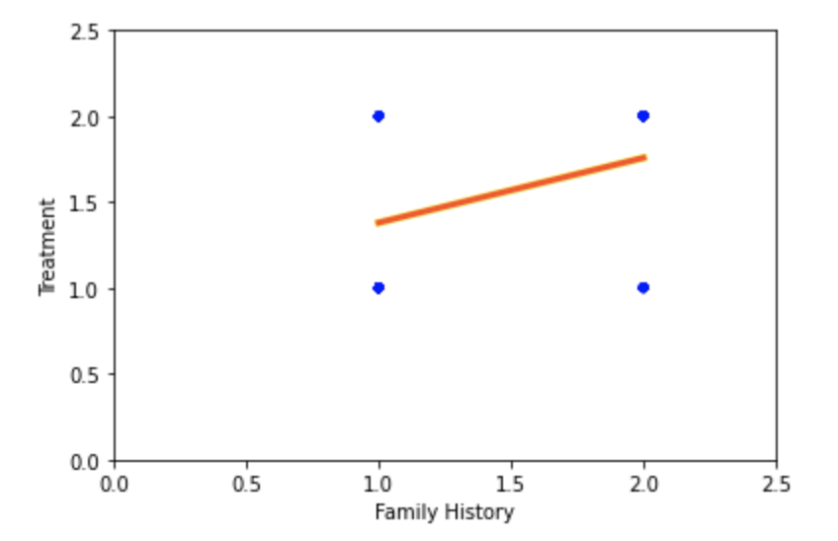
Hypothesis Testing & Regression Analysis
Variables used is ‘family_history’ and ‘Treatment’
Hypothesis testing gives p value of 0.0 which means the null hypothesis is rejected and my test is statistically significant.
Regression Analysis shows that people with Family history are more aware and inclined to take medical help if needed.

